Slide 1
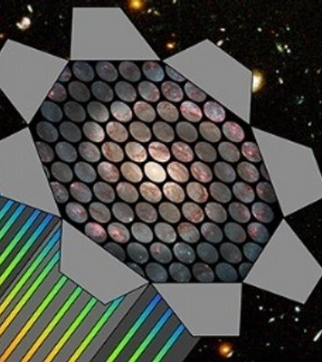
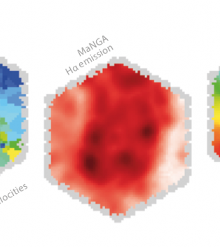
Internal Kinematics of Galaxies in Relation to their Morphological Evolution Using MaNGA Survey
Juan Pablo Alfonzo
Advisor: Dr. Mubdi Rahman

Slide 2
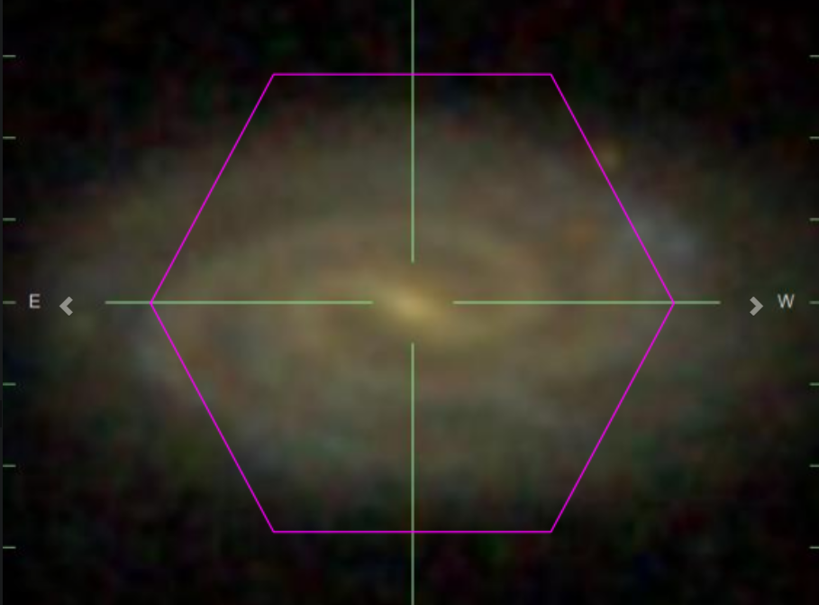
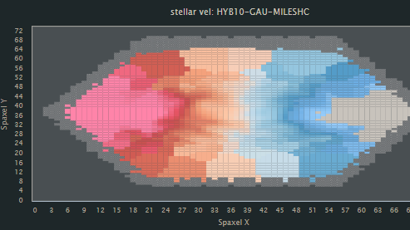
Research Goal
Studying internal kinematics between the 3 major types of galaxies
Star Forming Galaxies (SFGs)
Quiescent Galaxies (QGs)
Green Valley Galaxies (GVGs)
What makes MaNGA Survey Unique?
Spectral Measurements across the face of 10,000 different galaxies at low red-shifts
How are trends being studied?
Primary Component Analysis (PCA)
Source: [1]

Slide 3
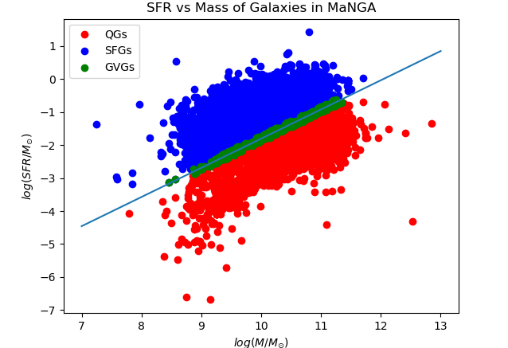
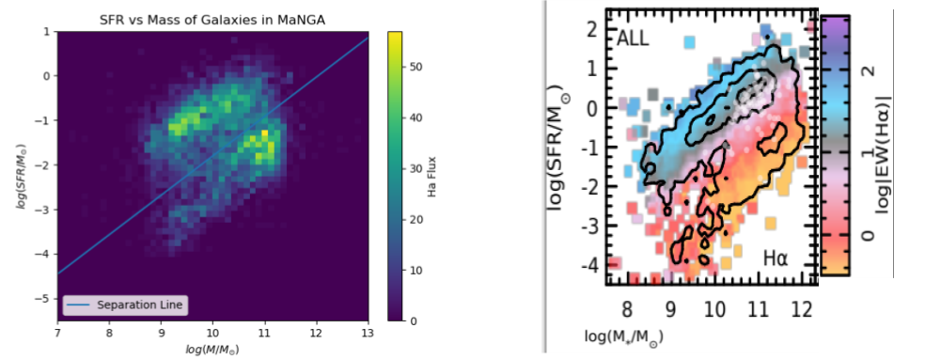
Classification 1: Log SFR vs Log Mass
Source: [2]

Slide 4
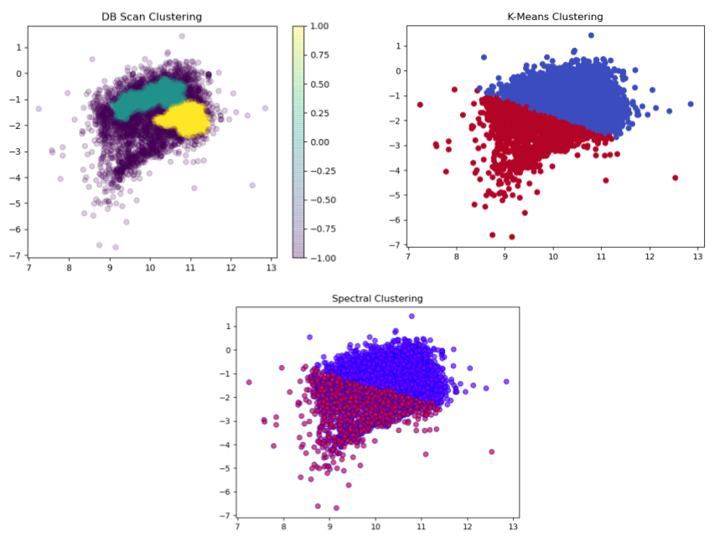
Classification 2: Clustering Algorithms

Slide 5
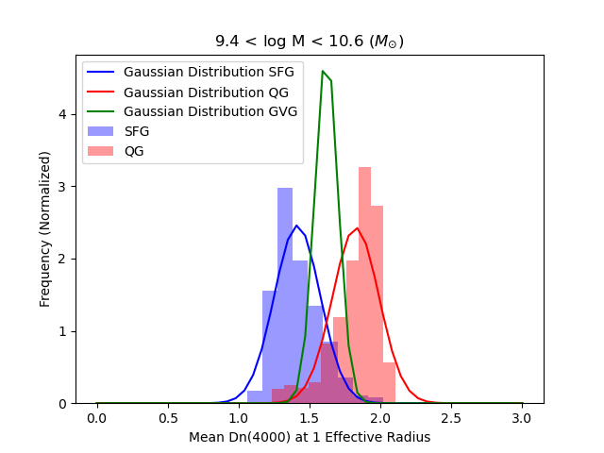

Slide 6
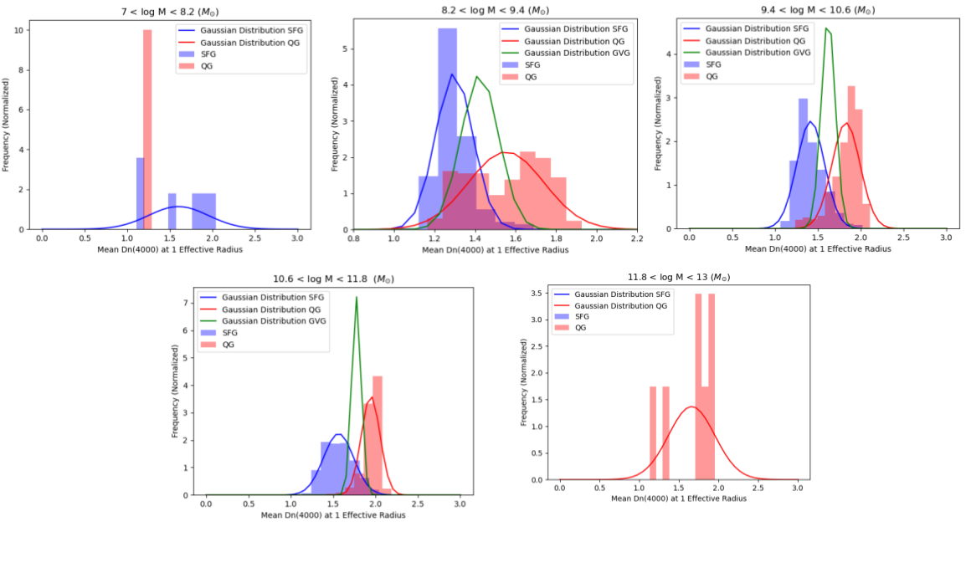
Classification 3: Gaussian Distributions
Source: [3]

Slide 7
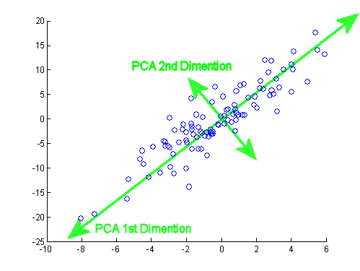
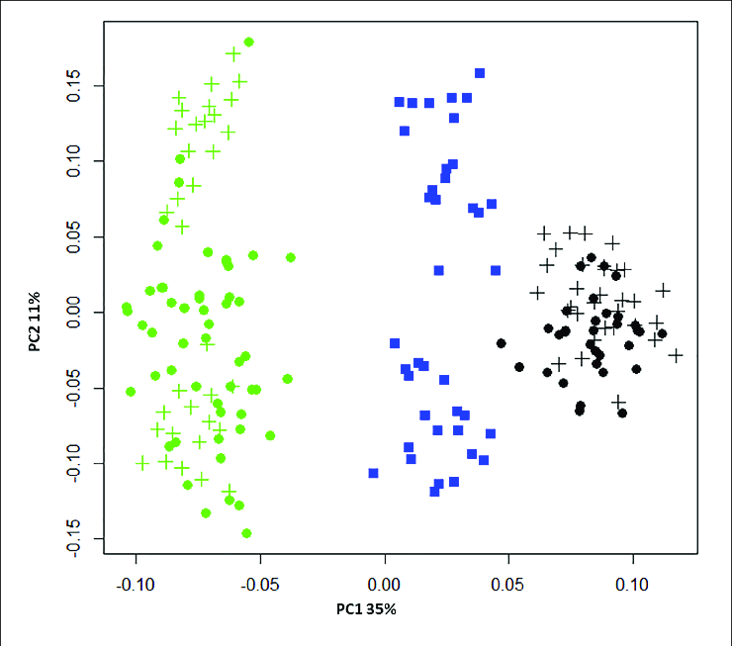

Crash Course in PCA

Slide 8
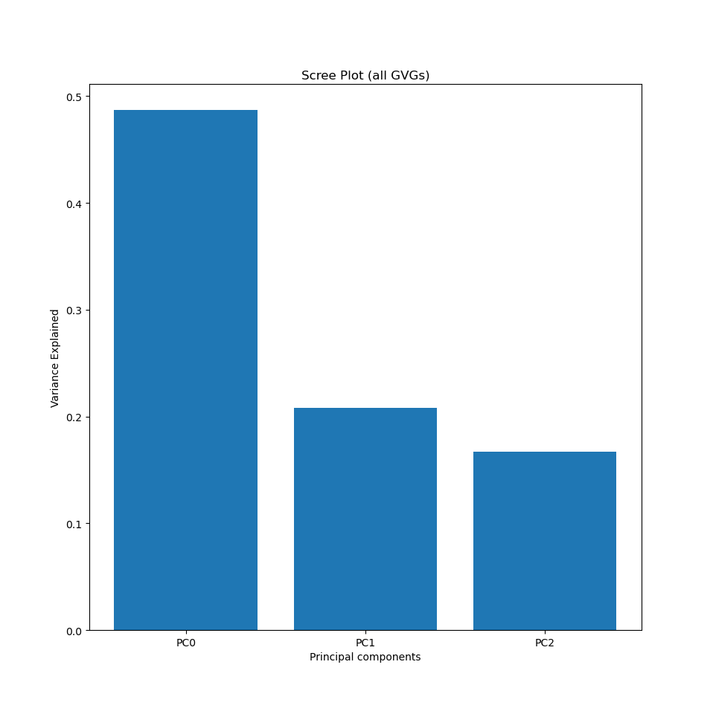
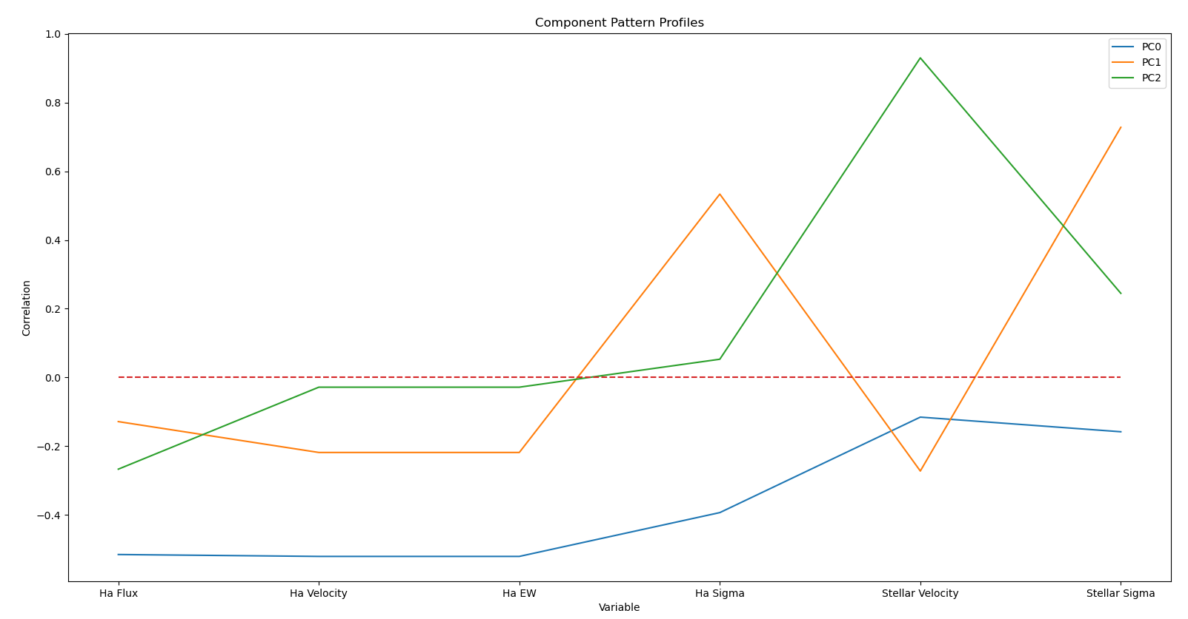
Preliminary PCA Analysis

Slide 9
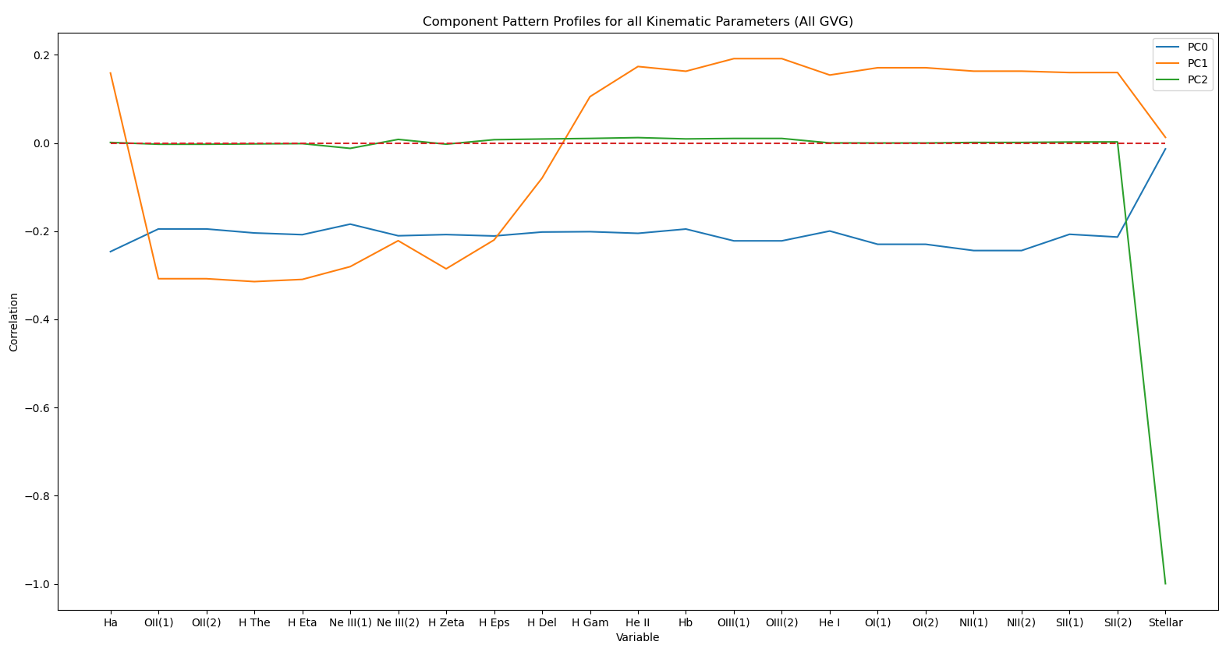

Slide 10
Groups Being Studied
From Gaussian Distribution Classification Method we have the following groups:
Bin 1,2,3,4, and 5 QG
All QG
Bin 1, 2, 3, and 4 SFG
All SFG
Bin 2,3, 4 GVG
All GVG
Bins defined from log Mass in Solar Units as follows:
Bin 1: 7<log(M)<8.2
Bin 2: 8.2<log(M)<9.4
Bin 3: 9.4<log(M)<10.6
Bin 4: 10.6<log(M)< 11.8
Bin 5: 11.8<log(M)<13

Slide 11
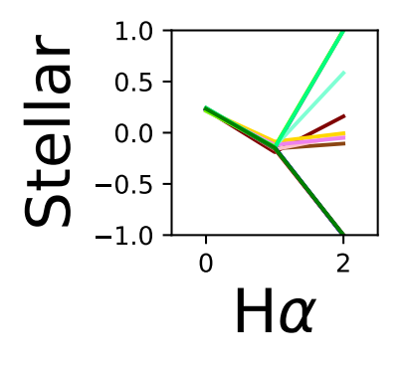
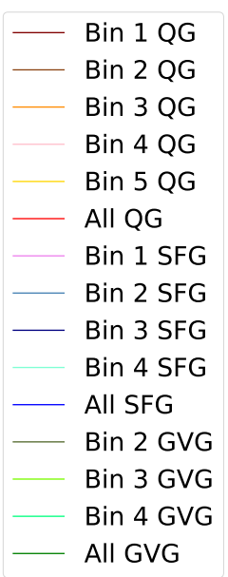
How to Compare Across Various Groups?
Looking at one specific cell

Slide 12
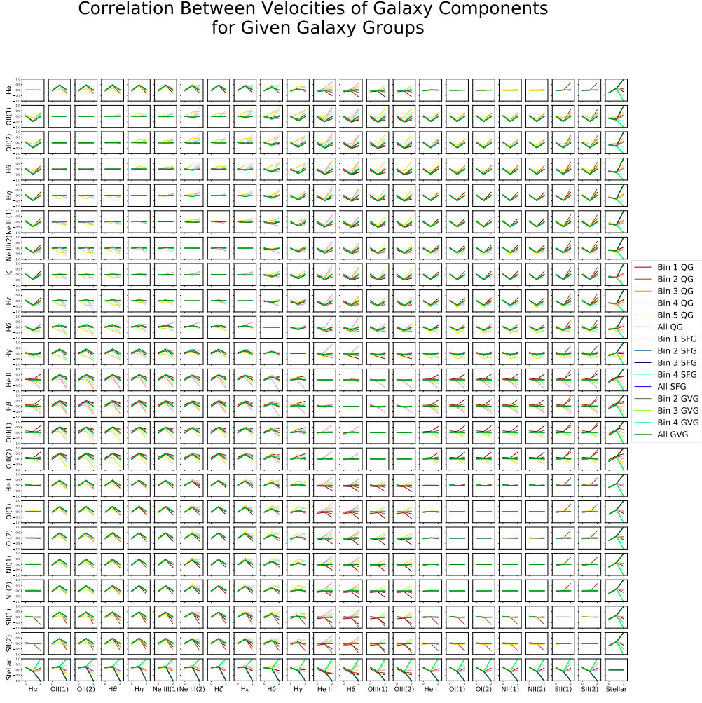

Slide 13
Anti-Symmetric Matrix!

Slide 14
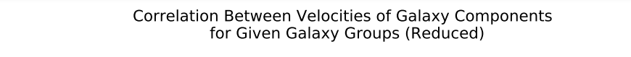
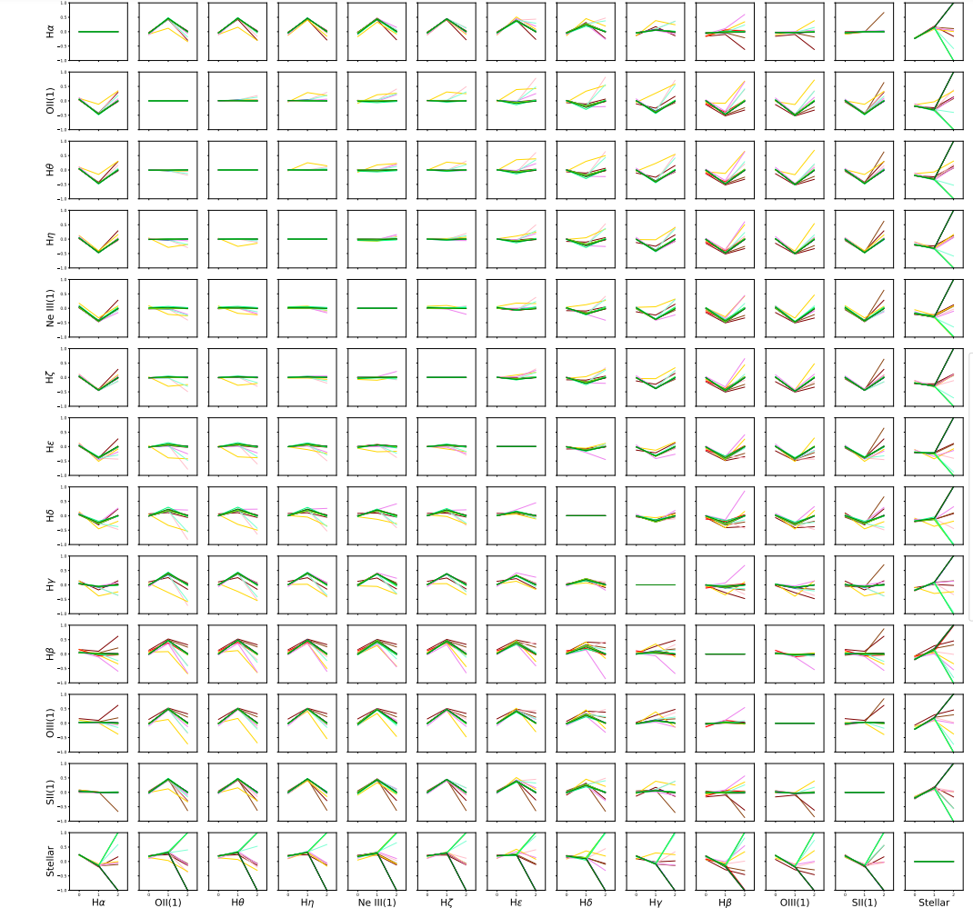
Correlated Variables Across
All Galaxy Groups
Hα
He I
Hε
OII(1)
SII(1)
OI(1)
OI(2)
NII(1)
NII(2)
Ne III(2)
OII(2)
SII(2)
OIII(1)
OIII(2)
Hβ
He II
Remove Redundant Variables Down from 23 to 13 Variables

Slide 15
Stellar Velocities Most Varied to any Other Velocity Along the Galaxy Groups
Key Takeaways:
Why is stellar so different from everything else in the galaxy?
Stars move very differently than gasses in galaxies
Major Difference in GVGs of different Bins along PC2
High and Low mass GVGs have almost opposite trends
Bin 4 SFG the sole non GVG group to have a wide variance

Slide 16
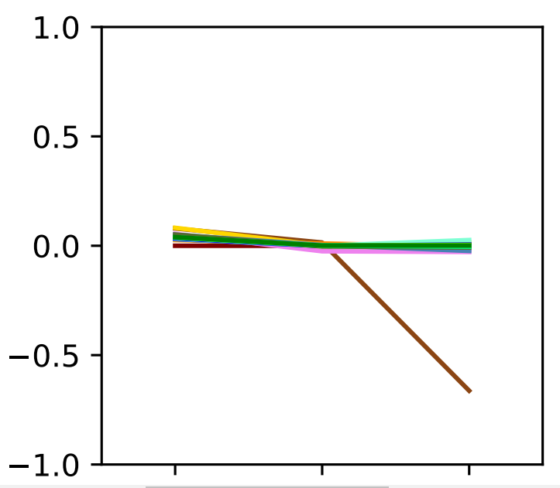
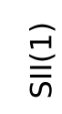
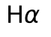
SII(1) and Hα Variation for Bin 2 QG
Key Takeaways:
Variance only in PC2
All other Galaxy Groups except Bin 2 QG are quite uniform
Consider this is not just for SII(1) and Hα, but for all other variables that are correlated with them as outlined in the earlier chart

Slide 17
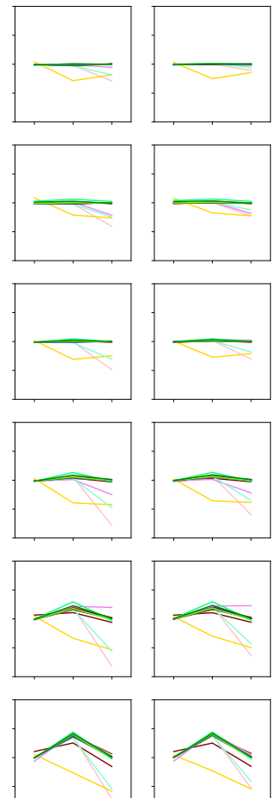
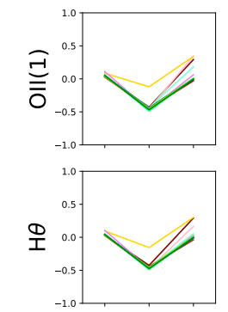
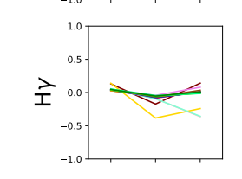
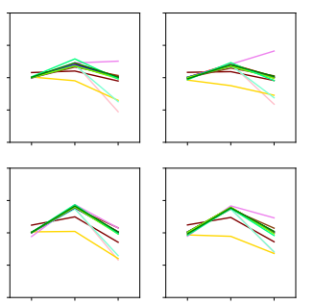
Bin 5 QG: A small, but odd group
Key Takeaways:
Bin 5 QG (the heaviest of the QG galaxies) has only 7 members
Bin 5 QG galaxies seem to have different velocity correlations across a good amount of the variables, compared to other groups
Not only PC2 differences as we have seen before but even major differences along PC0 and PC1

Slide 18
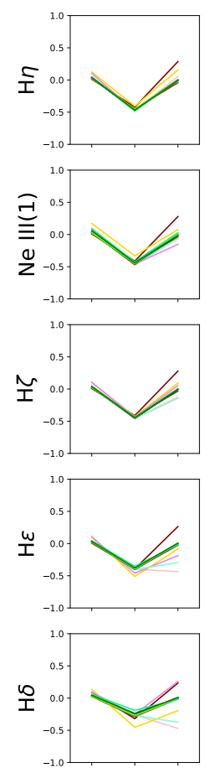
Consistent Anti-Correlation with Hα Across All Groups
Key Takeaways:
Along PC1 for all groups we see that these selections of variables have a semi (-0.5) anti correlation with Hα
Bin 5 QG and Bin 1 QG both deviate more than other groups in PC0 and PC2
Why both very low and high mass QGs?

Slide 19
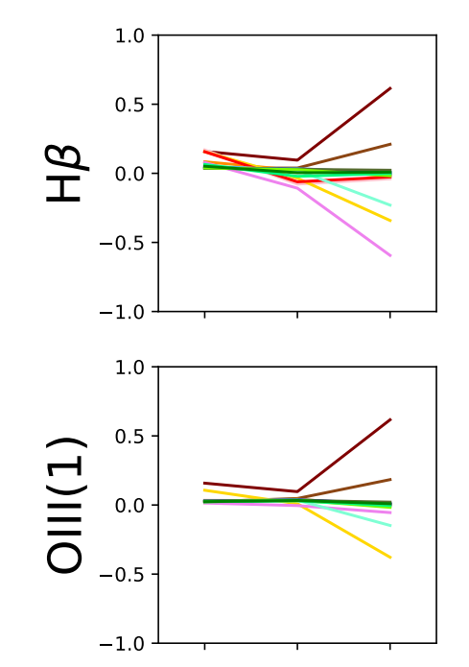
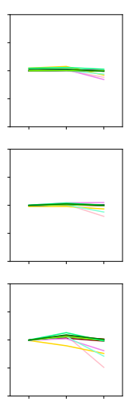
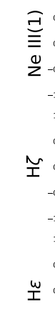
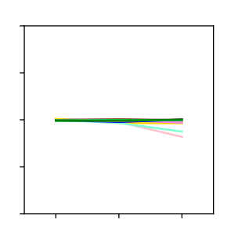
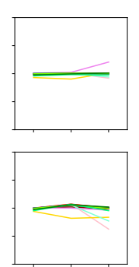
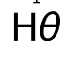
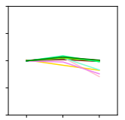
Bin 1,4 SFG and Bin 4,5 QG Diverging From other Groups across PC2
Key Takeaways:
These 4 specific groups seem to follow the same trend as every other galaxy for these variables until we get to PC2
Especially for the left side figure we get massive differences in correlation in PC2 despite being very close across PC0 and PC1

Slide 20
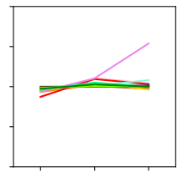
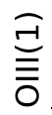
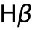
Bin 1 SFG PC2 Diverging for OIII(1) and Hβ
Key Takeaways:
Bin 1 SFG is the sole outlier group. Every other groups has almost perfect correlation across these two variables
Could it be somehow be physically tied to its low mass/being star forming (as this is what makes it different from any other group)

Slide 21
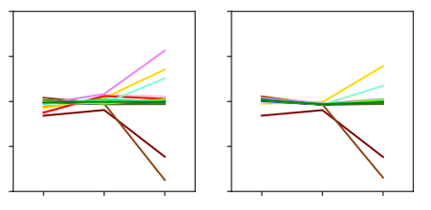
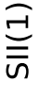
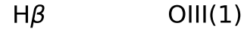
Variance in Different QG Groups
Key Takeaways:
We have the usual suspects of Bin 1,4 SFG and Bin 5 QG being outliers, mostly in PC2
Bin 1,2 QG completely anti-correlated relationships to those in Bin 5 QG
Mass related correlation between these variables?

Slide 22
How sure are we of these results?
How can we gauge an error for the PCA analysis? Bootstrapping!
Bootstrapping resamples the data and runs the PCA on the resampled data. This is done for a given number of reps
A way to create artificial noise in the data and gauge how well the PCA reacts to it
In this case it does the change the PC vector’s components along a given variable by more than 0.2, i.e., relatively small
Additionally, the size of the error returned by Bootstrap did not change with the different sized galaxy groups!
We can be quite confident that these trends are pointing to something of physical significance in the galaxies

Slide 23
Conclusion and Possible Future Plans
This project had 3 major conclusions
Classification of MaNGA Galaxies (SFG,QG, GVG)
Correlated Variables across All Galaxy Groups
Unique Trends of Specific Galaxy Groups for Specific Variables
Future Plans:
Explore the physical significance of these trends
What is at play at these very low/high mass galaxies?
What are the universal galaxy law(s) the correlated variables are telling us?

Slide 24
Sources
[1] Sebastian F. Sanchez. Spatially-Resolved Spectroscopic Properties of Low-Redshift Star-Forming Galaxies. Annual Review of Astronomy and Astrophysics, 58, 2020.
[2] Brian Cherinka, Brett H. Andrews, Jose Sanchez-Gallego, Joel Brownstein, Maria Argudo-Fernandez, Michael Blanton, Kevin Bundy, Amy Jones, Karen Masters, David R. Law, Kate Rowlands, Anne-Marie Weijmans, Kyle Westfall, and Renbin Yan. Marvin: A Tool Kit for Streamlined Access and Visualization of the SDSS-IV MaNGA Data Set. , 158(2):74, Aug 2019.
[3] Ignacio Ferreras James Angthopo and Joseph Silk. Exploring a new definition of the green valley and its implications. Monthly Notices of the Royal Astronomical Society, 488, 2019.

Slide 25

Thanks for Listening!

Slide 26
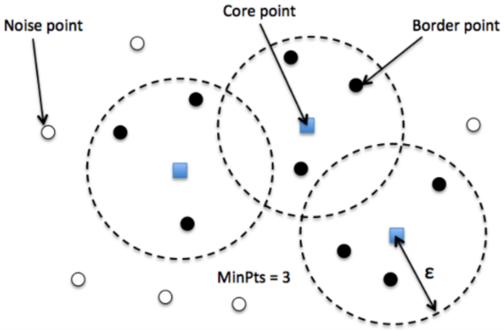
How does DB Scan Work?
Give two inputs, epsilon and Minimum points
Runs algorithm visually depicted on the left to create clusters

Slide 27

DB Scan at Work

